Slide 1
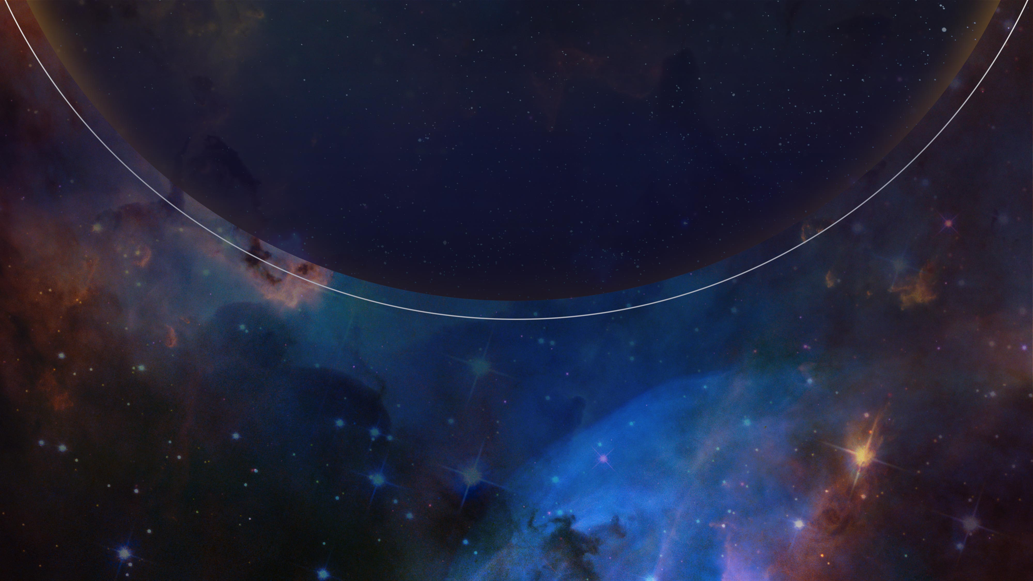

Rectifying Poor Flux Calibration of COS Data due to Bad Time Intervals
EXPANDING THE FRONTIERS OF SPACE ASTRONOMY
Andrews Damoah, Sten Hasselquist

Slide 2
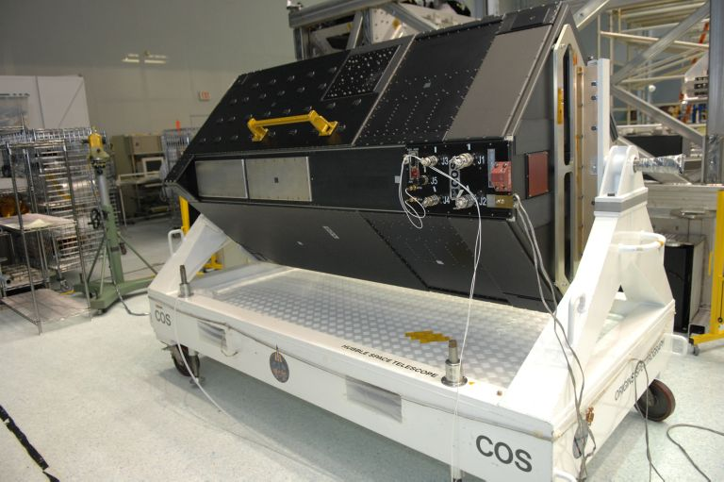
The Cosmic Origins Spectrograph (COS)
The Cosmic Origins Spectrograph (COS) was designed to study the origins and evolution of astronomical objects in the ultraviolet wavelength range
COS is equipped with two observing channels; the Near-Ultraviolet (NUV) detector, which is sensitive to wavelengths between 1650 to 3200 Å, and the Far-Ultraviolet (FUV) detector, which is sensitive to wavelengths between 900 and 2150 Å
Exposures by COS can be obtained in either TIME-TAG or ACCUM. TIME-TAG, in addition to recording photon event information, stores time markers in 32 ms intervals
An image of the COS instrument (via Wikipedia)

Slide 3
COS Flux Calibration
COS provides flux calibrated UV spectra for a variety of astronomical objects from count rates using the FLUXTAB reference file.
Flux measurements across different exposures of the same object are expected to be within 2% precision of each other and 5% accurate to the true flux of the object.
Count rates are generally constant over the duration of a single exposure. However, variability can sometimes be observed, potentially leading to poor flux calibration
Some variability can be intrinsic to the object while others can be due to issues with the telescope/COS detector during observations (e.g., target drifts out of the aperture)
Affected exposures can be corrected using the BADTTAB reference file

Slide 4
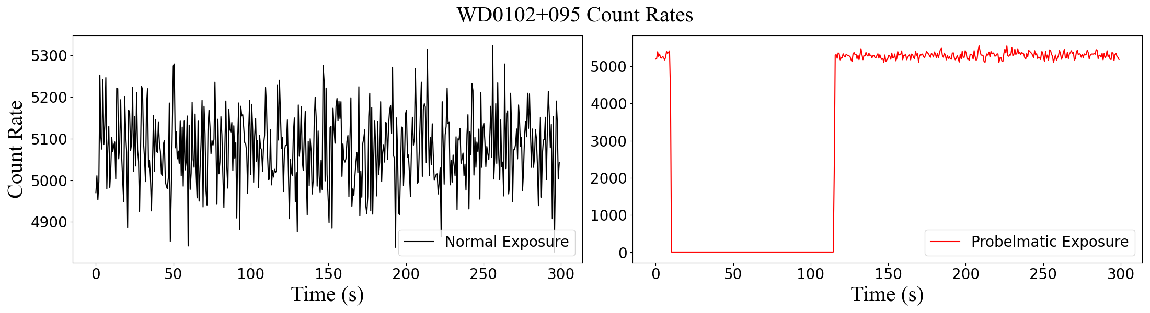
Background
The figure below is a plot of the binned count rate as a function of time for the White Dwarf WD0102+095 (FUVA).
The x-axis is the time in seconds while the y-axis is the count rate
The line in black is an exposure with the expected count rate for this object while the line is red is an exposure with an observed drop in counts

Slide 5
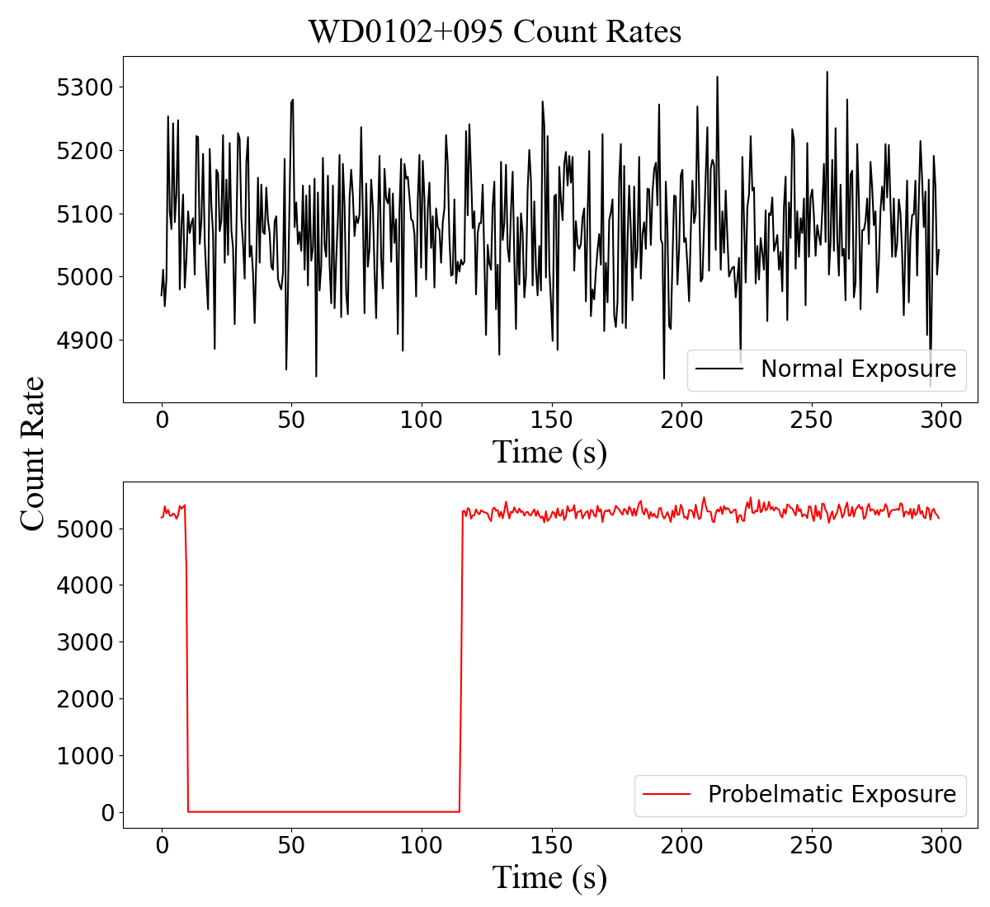
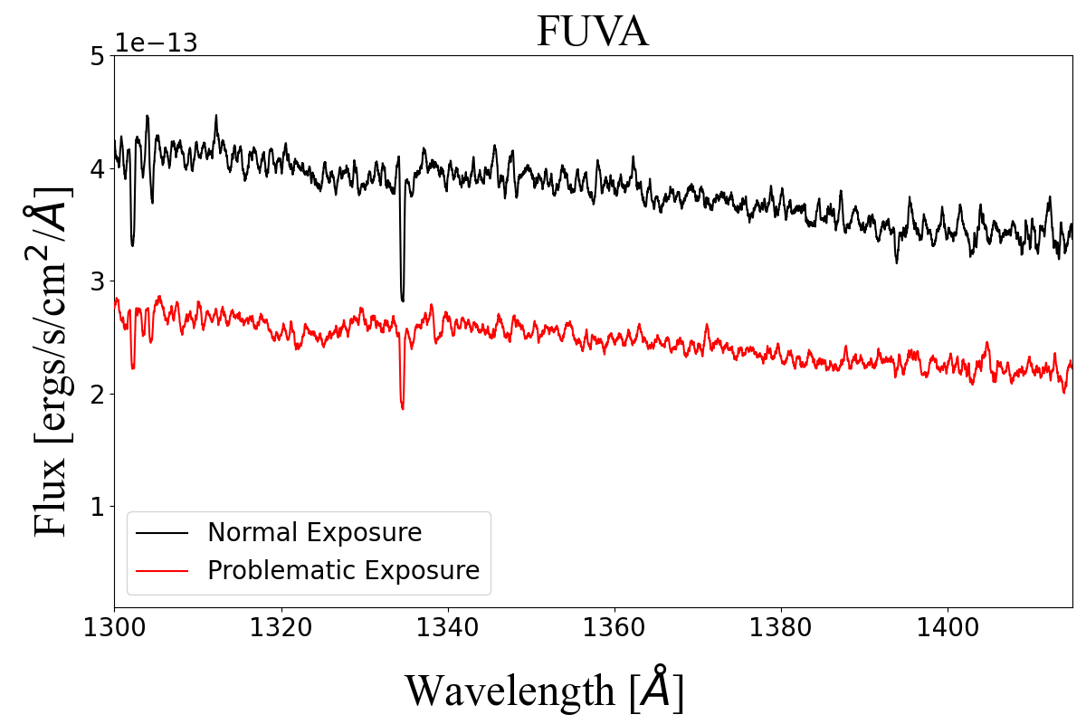
Background
The observed drop in count rate also led to a lower flux measurement.

Slide 6
Research Goals
We want to find and classify variable exposures into two groups:
Exposures with intrinsic variability
Exposures with variability due to telescope/detector issues (bad time intervals)
Exposures with variability due to bad time intervals can be corrected using the BADTTAB reference file
We generally won’t want to correct intrinsically variable objects, but can provide a catalogue of COS objects that are intrinsically variable over the time period of a single orbit

Slide 7
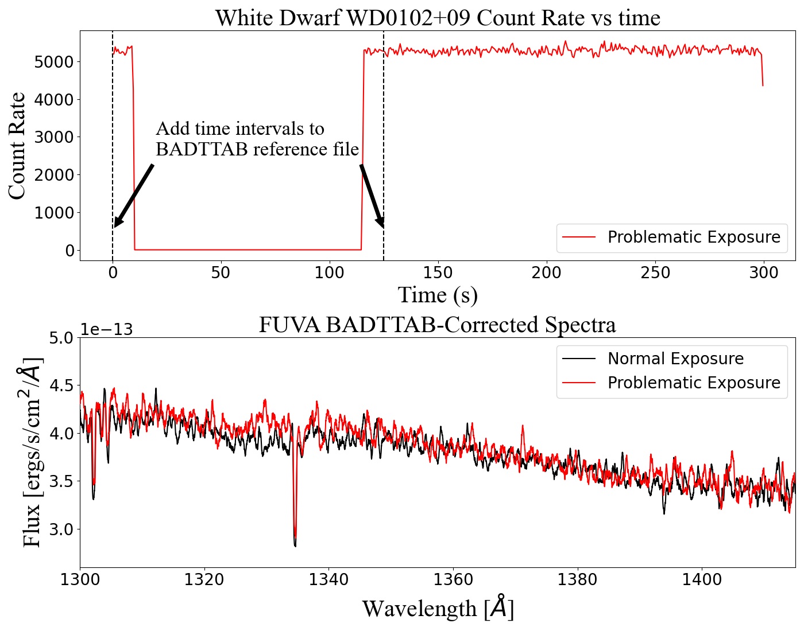
Research Goals
Defining a start and end interval in MJD format in the BADTTAB reference file excludes this counts from the final spectrum.

Slide 8
Methodology
Preprocessing of exposure count rates begins with the following steps:
Counts are binned in 0.64 second intervals (0.16 s for NUV exposures)
Obvious airglow lines are masked
Background subtraction is performed
The preprocessed data is then run through our exposure classification algorithm which relies on two main components:
Machine learning to detect variable features in an exposure’s count rate over time
Statistical analysis to summarize the detected variable features
Machine learning component utilizes LocalOutlierFactor for anomaly detection
Statistical analysis component utilizes Z-scores, outlier segment lengths, and outlier segment counts

Slide 9
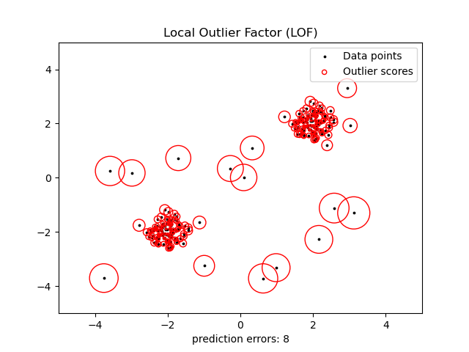
Methodology: Machine Learning Component
LocalOutlierFactor (LOF) is an unsupervised outlier detection algorithm
The algorithm finds outliers by comparing local density around a datapoint to the local densities of its neighbors (datapoints with low density compared to its neighbors are likely to be outliers)
We use LOF to find unexpected rises and drops in count rate over an exposure’s duration
For each data an outlier score is computed signifying the deviation in local density to its neighbors. Data points with larger scores are more likely to be outliers
(via Scikit-Learn)

Slide 10
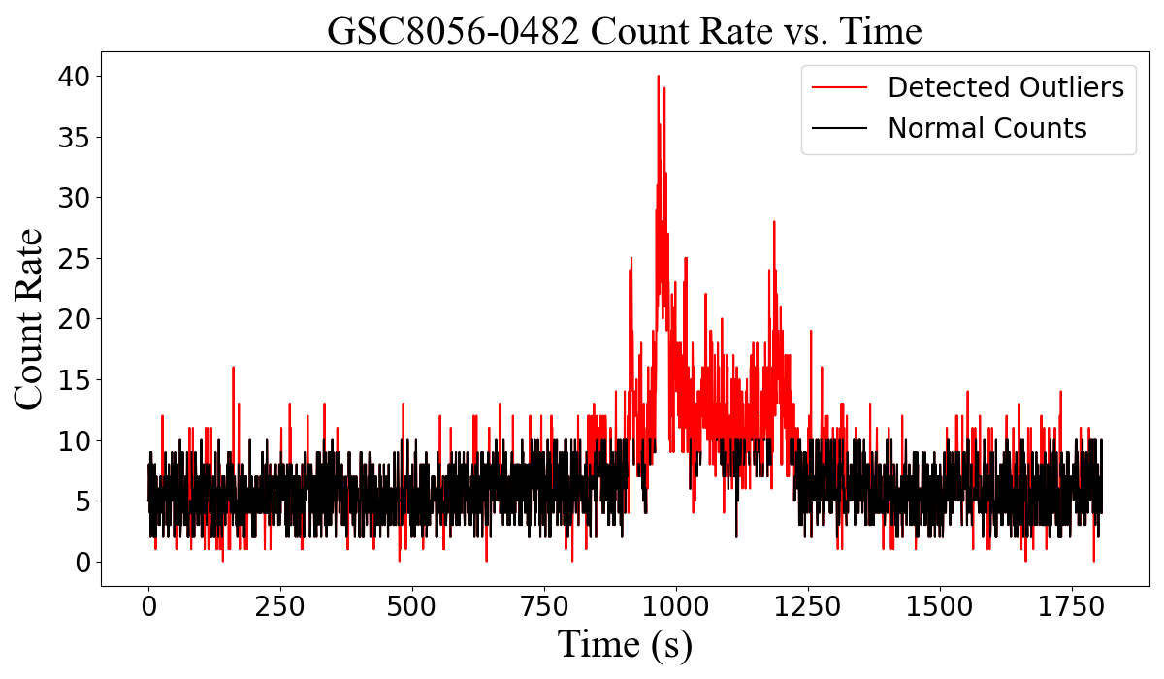
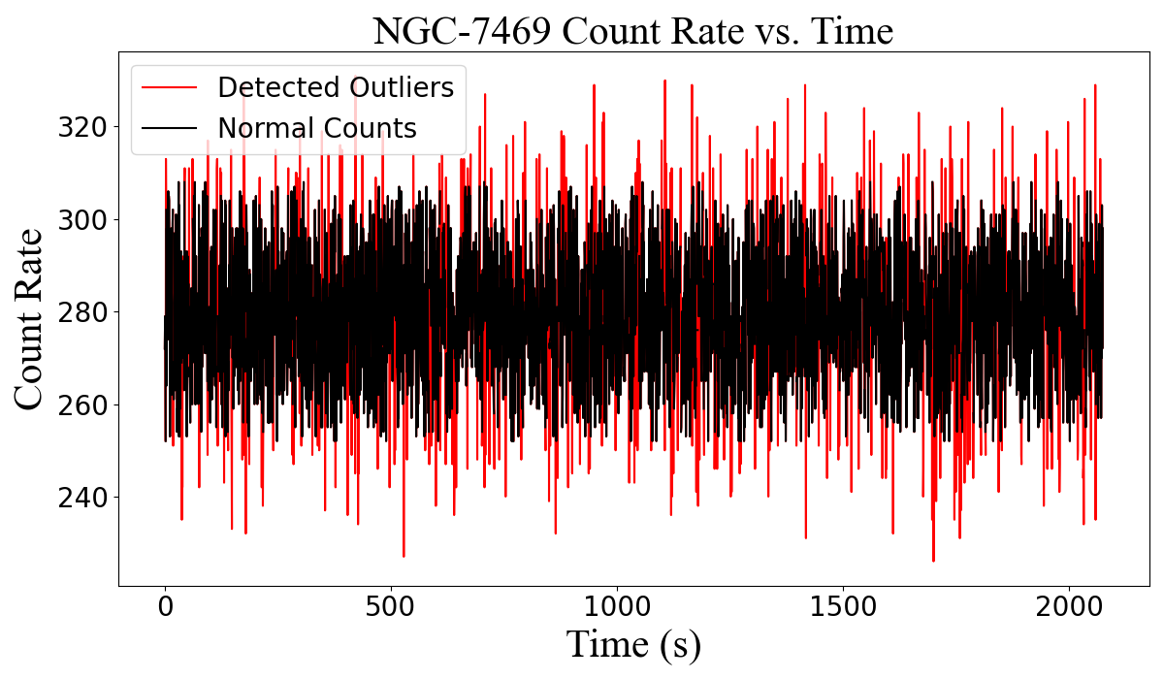
Methodology: Machine Learning Component
In normal exposures, LOF only detects noise. In variable exposures, LOF can detect regions where rises and drops in count rates occur. This can include intrinsic variable features such as flares and eclipses.
Notes:
Left: M Dwarf
Right: Intermediate Spiral Galaxy

Slide 11
Methodology: Statistical Analysis Component
Statistical Analysis parameterizes the outliers detected in LOF by summarize 3 components:
Maximum length of the outlier segments
Number of significant outlier segments
Mean z-score of the maximum outlier segment
Z-score is defined as the number of standard deviations a count rate outlier is from the median count rate across the entire exposure
Each component allows us analyze the relative length, number, and direction (rise or fall) of variable features observed in the count rates.

Slide 12
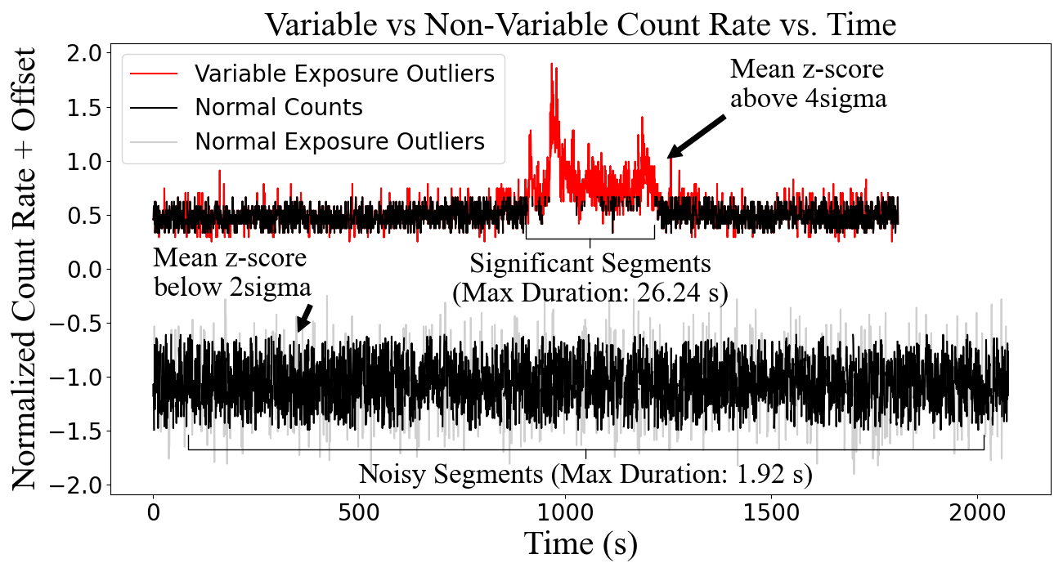
Methodology: Statistical Analysis Component
The visual above highlights how our algorithm can detect and differentiate the outliers between exposures with and without variability

Slide 13
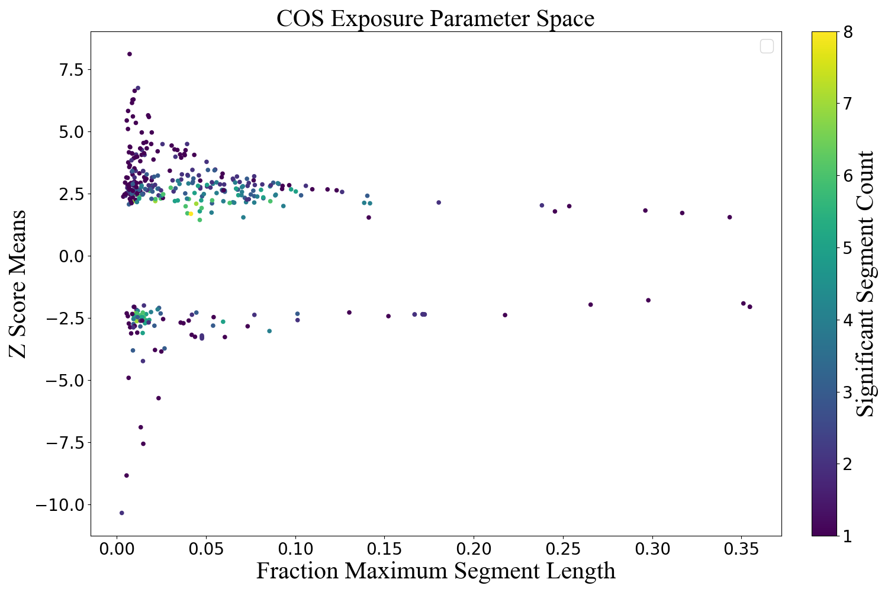
Methodology: Parameter Space
We generated a parameter space using the three parameters from the statistical analysis
Exposures with no significant segments and maximum segment length less than 8 were removed from the plot

Slide 14
Methodology: Parameter Space
We generated a parameter space using the three parameters from the statistical analysis
Exposures with no significant segments and maximum segment length less than 8 were removed from the plot

Slide 15
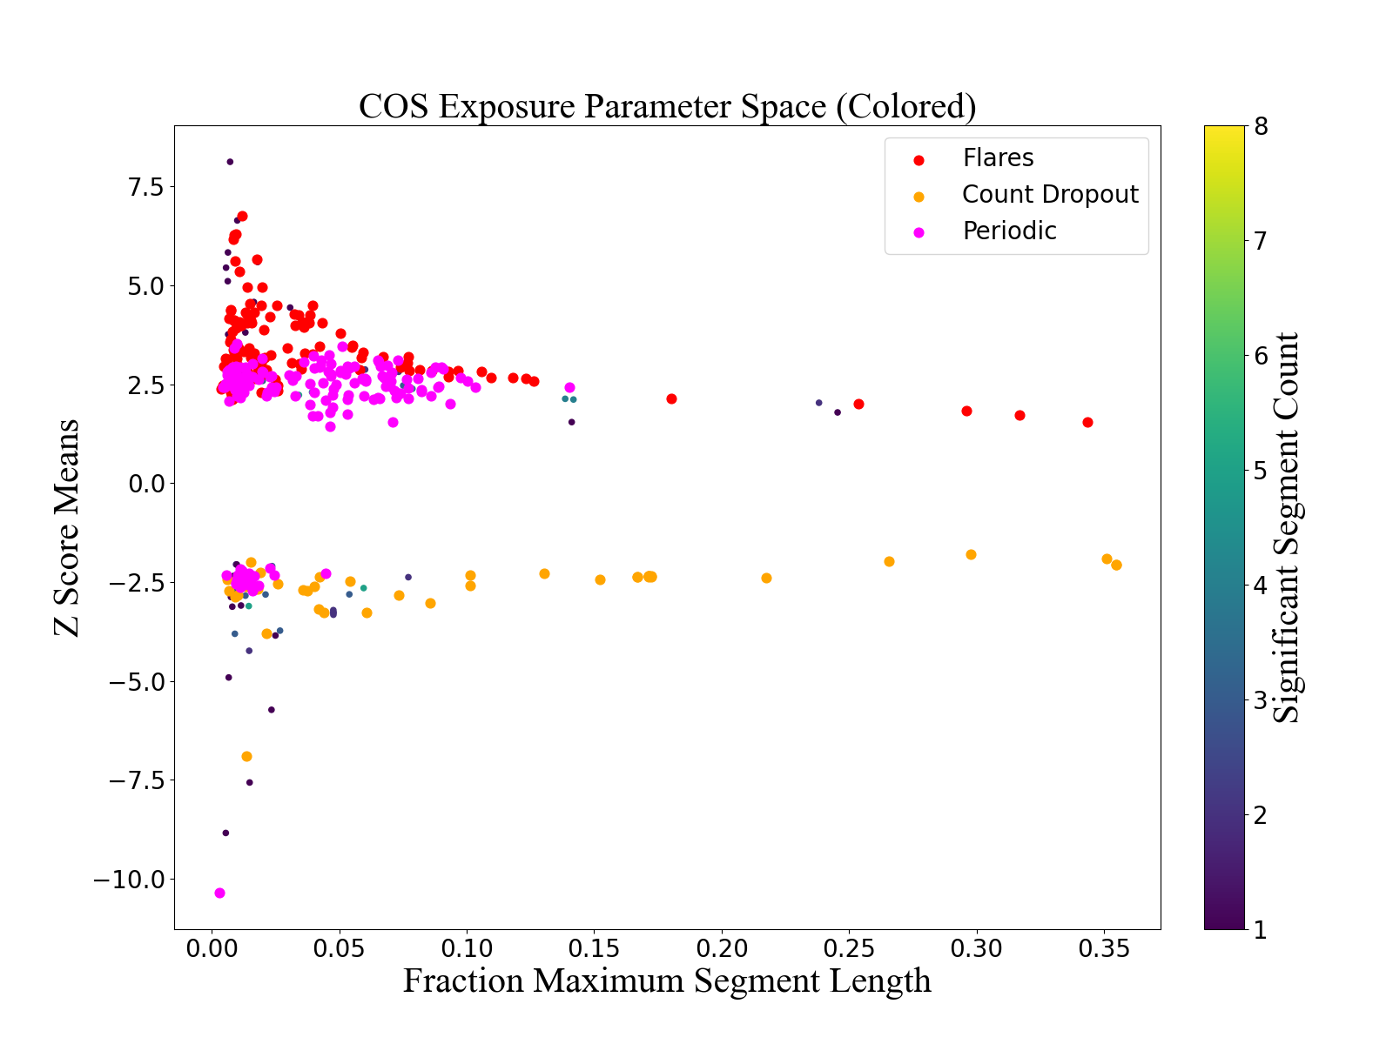
Methodology: Parameter Space

Slide 16
Methodology: Parameter Space
We then used these parameters to generate a parameter space to highlight where different types of variable exposures can be found. This includes
Periodic (high number of segments, high segment duration, high |mean z-score|)
Flares (low number of segments, high segment duration, high mean z-score)
Count dropouts (low number of segments, high segment duration, low mean z-score)

Slide 17
Results: Classification
We ran this algorithm on all COS exposures (through Spring 2025)
Through this method, we identified:
35 count dropouts (11 of which needed to be corrected using the BADTTAB)
101 flares
124 periodic exposures
The full list of exposures will be available in the upcoming ISR

Slide 18
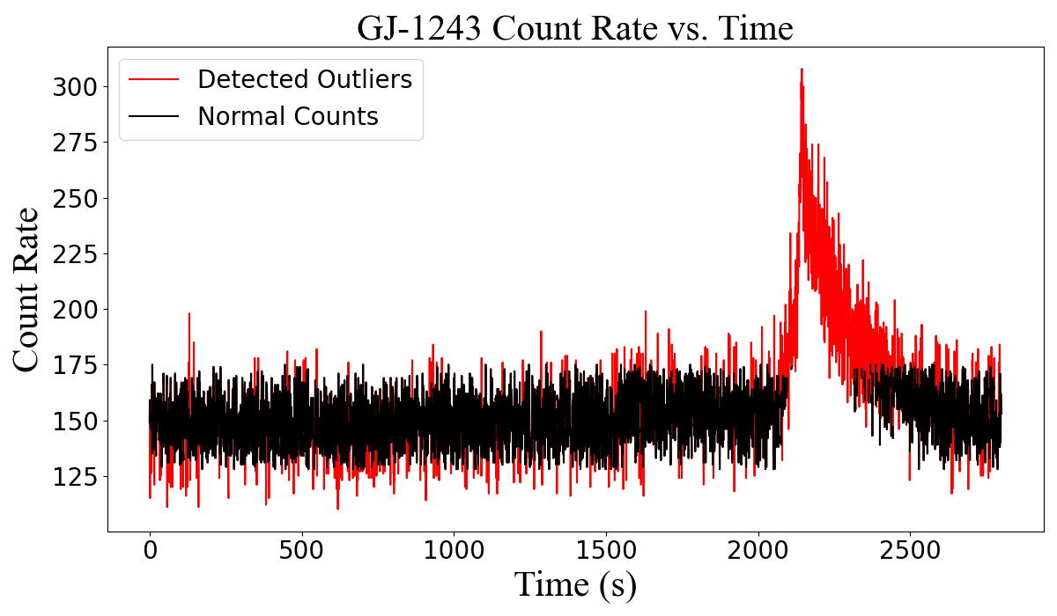
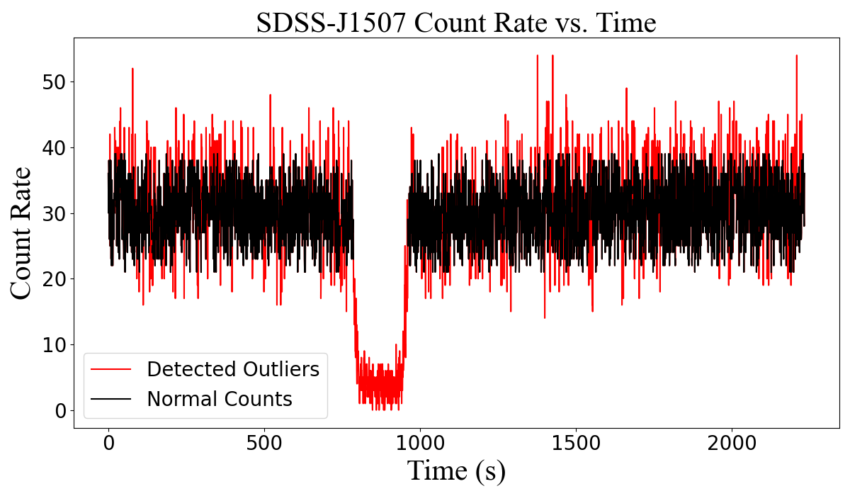
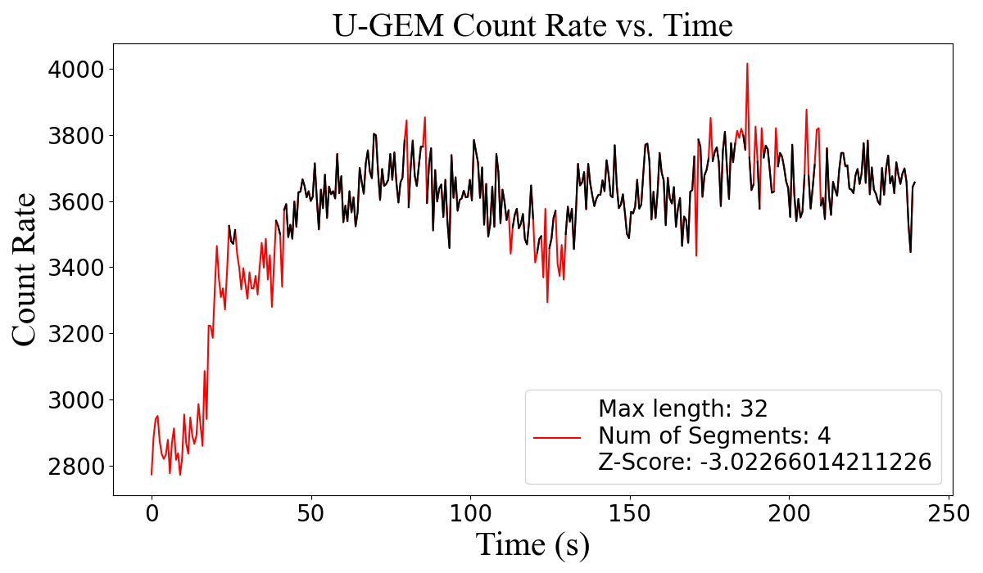
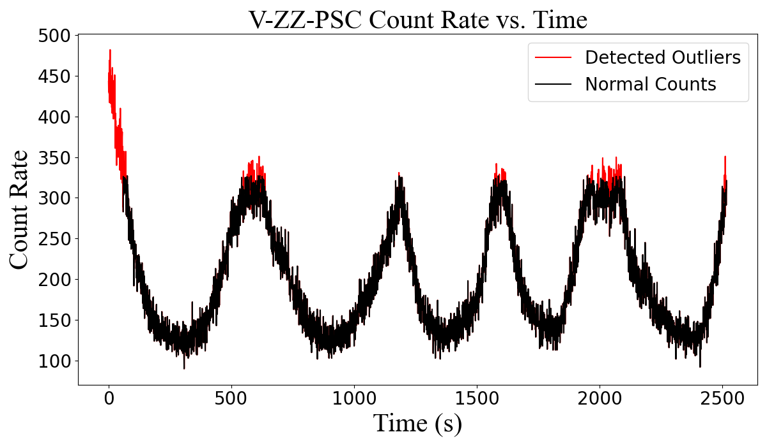
Results: Classification
Flares
Count Dropouts
(Eclipse)
Periodic
Count Dropouts
(BADTTAB)
Notes:
Top Left: M-dwarf
Top Right: Cataclysmic Variable (M-dwarf and brown dwarf)
Bottom Left: Not sure
Bottom Right: White dwarf

Slide 19
Results: Automated Bad Time Selection
We also developed two methods to automate the selection of bad time intervals:
Method one relies on locating the interval of the maximum outlier segment (which tells us when the drop occurs)
Method two utilizes the derivative magnitudes to find the interval where rapid changes in count rate occurs
We still plan to manually verify the BADTTAB times however these automated methods will provide a good starting point for figuring out how to define the intervals

Slide 20
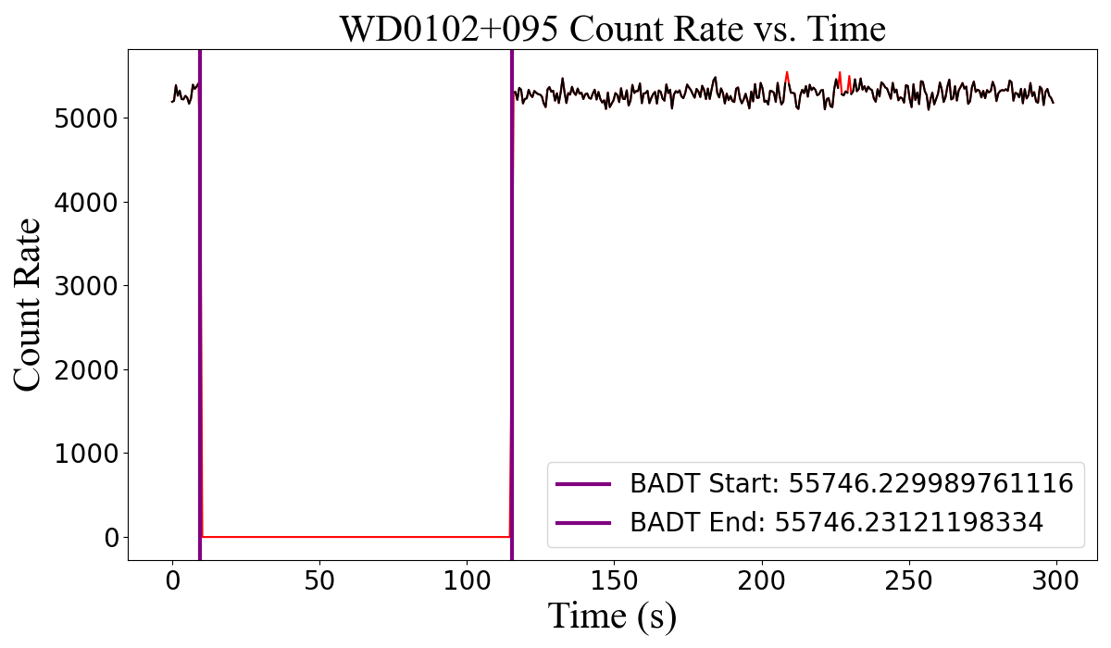
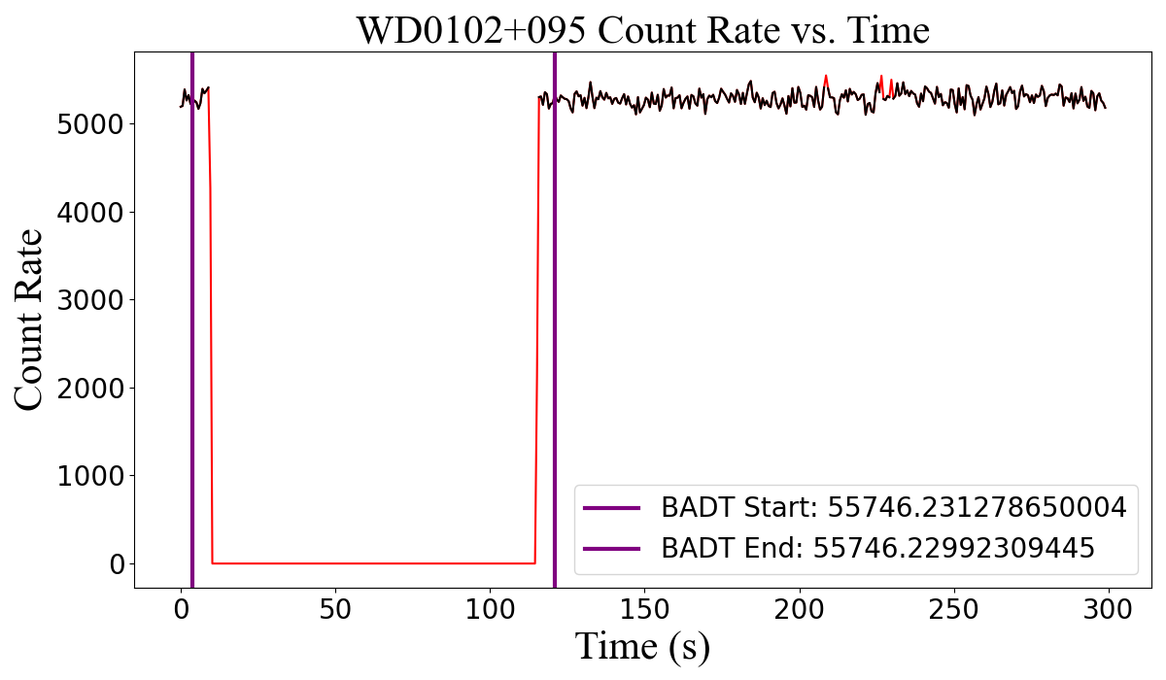
Results: Automated Bad Time Selection
Results from of our automatic bad time selection method. The plot on of the left shows the maximum segment method. The plot on the right shows the derivative-based method.

Slide 21
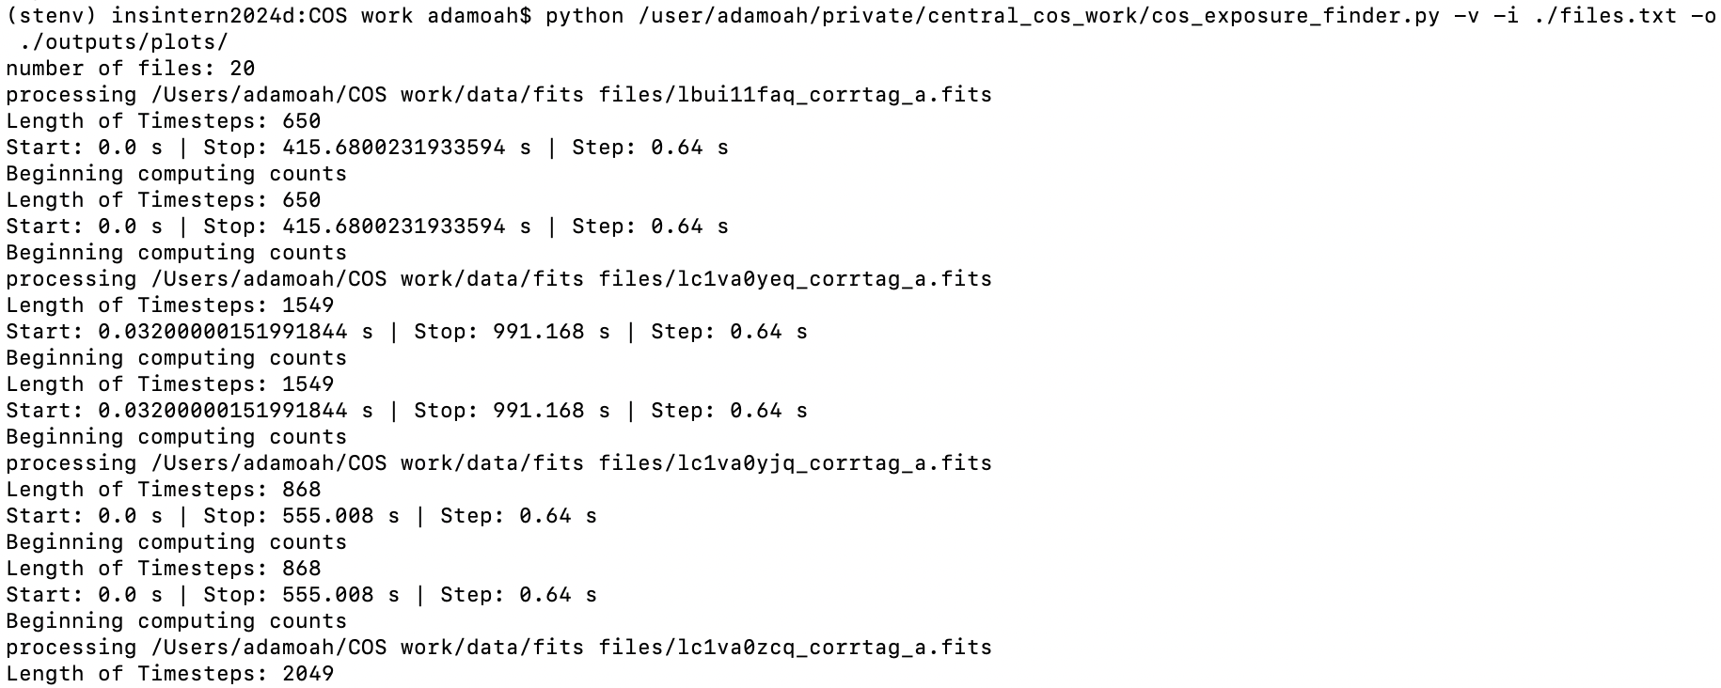
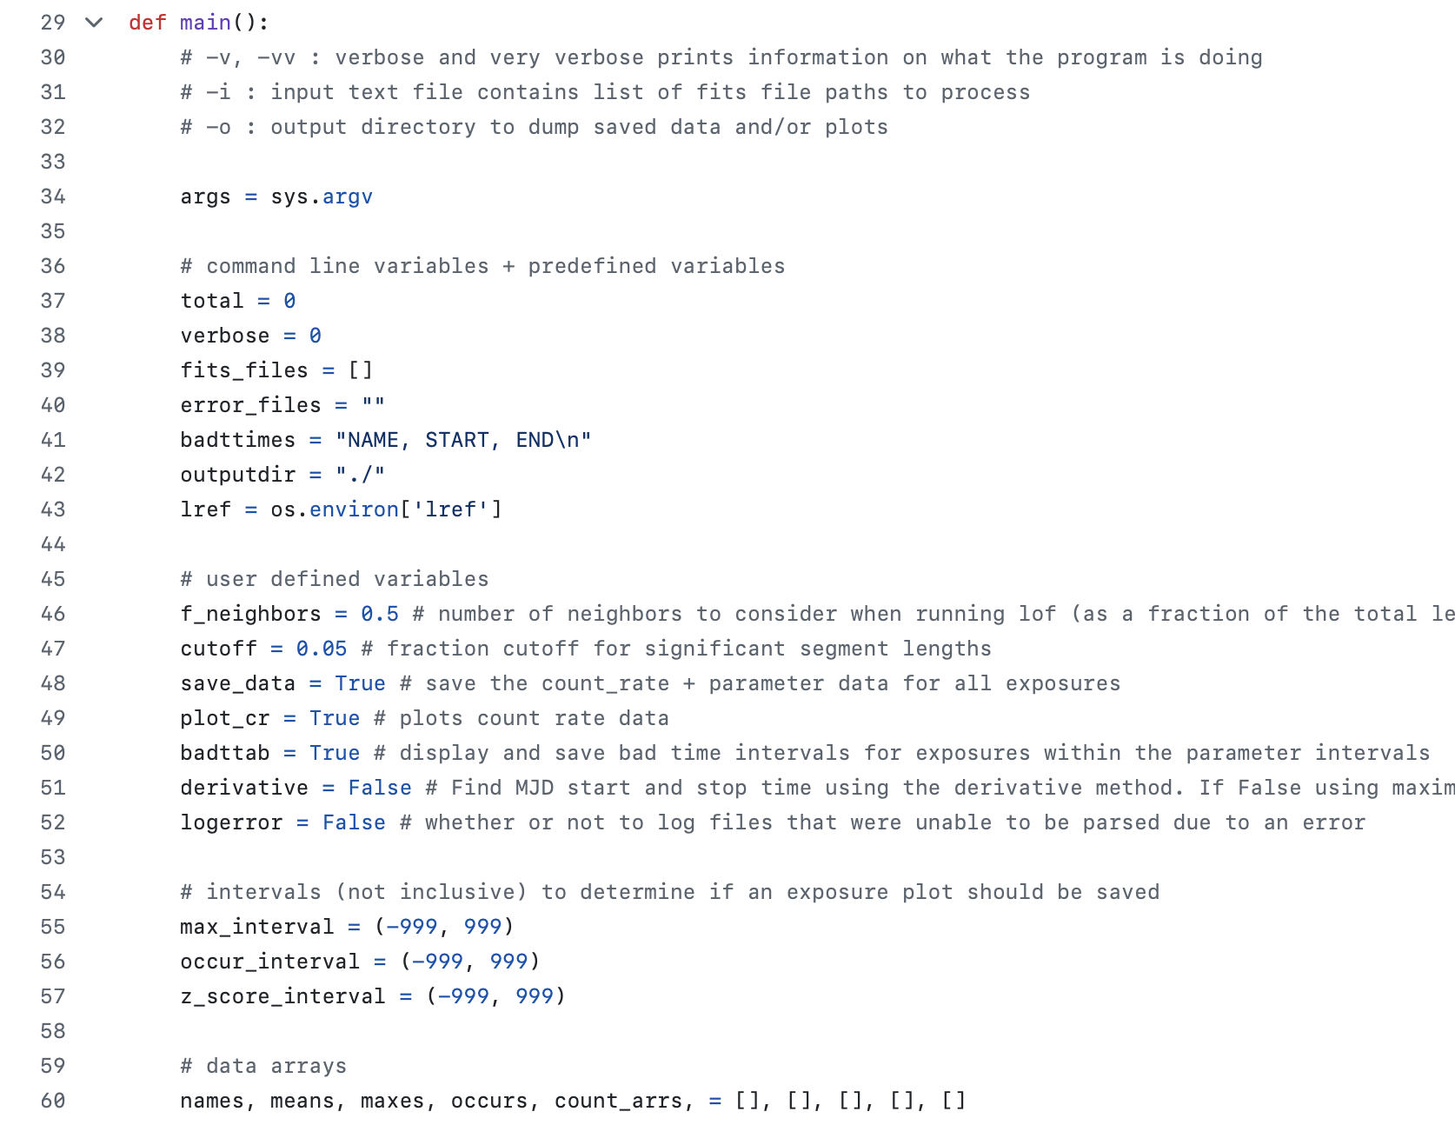
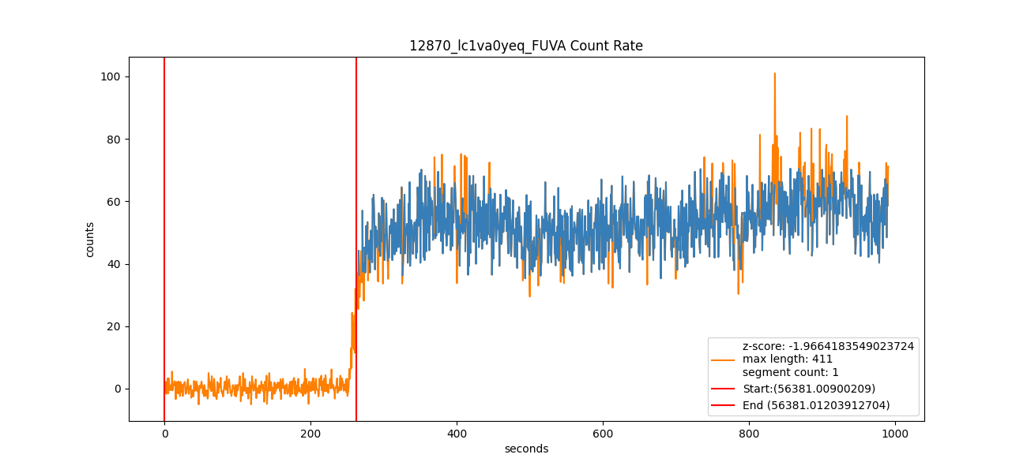
Github Code
Code can be found at: https://github.com/adamoah/COS-Variable-Exposure-Classifier

Slide 22
Github Code
Code can be found at: https://github.com/adamoah/COS-Variable-Exposure-Classifier

Slide 23
Conclusions
We have developed an algorithm that can classify exposures based on the features in their photon count rates including: flares, count dropouts, and periodic exposures
We also have an automated method to help identify the time intervals we want to enter into the BADTTAB for exposures with bad time intervals to fix their flux calibration
We have made code freely available in order to allow anyone to apply or improve our method using their own data from COS (and potentially other instruments)
We plan to release an ISR with more information on what we did and details on which exposures should be corrected using the BADTTAB and which exposures are of actual intrinsically variable objects

Slide 24
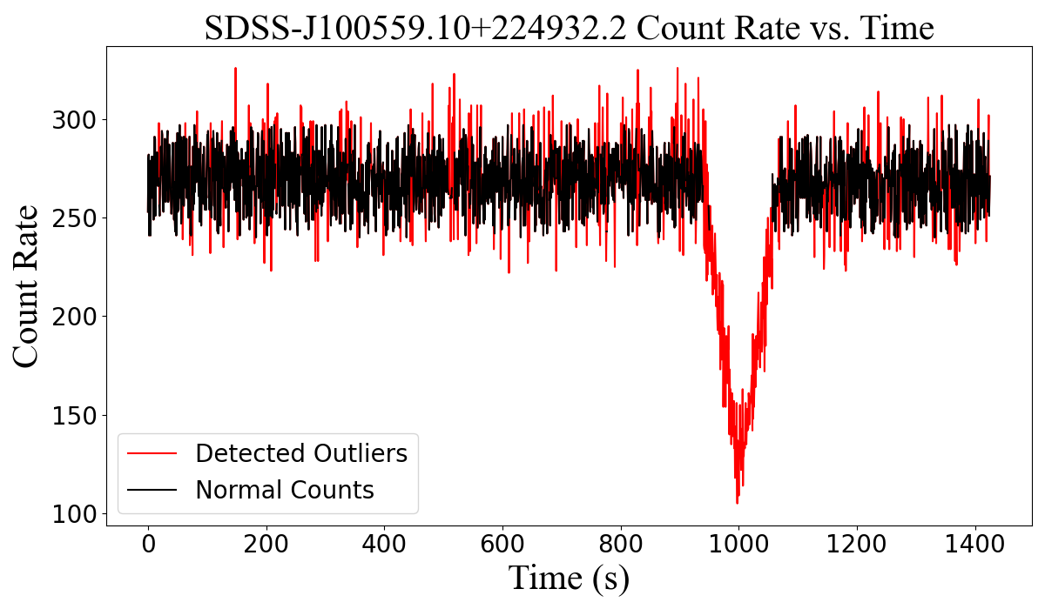
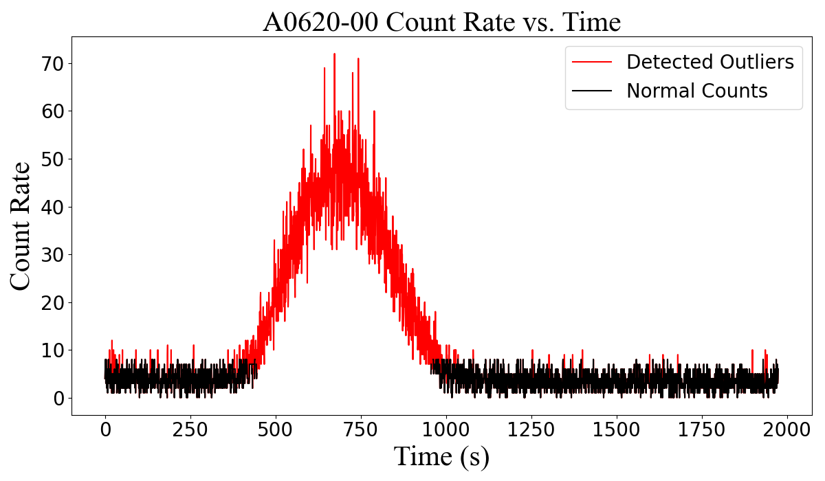
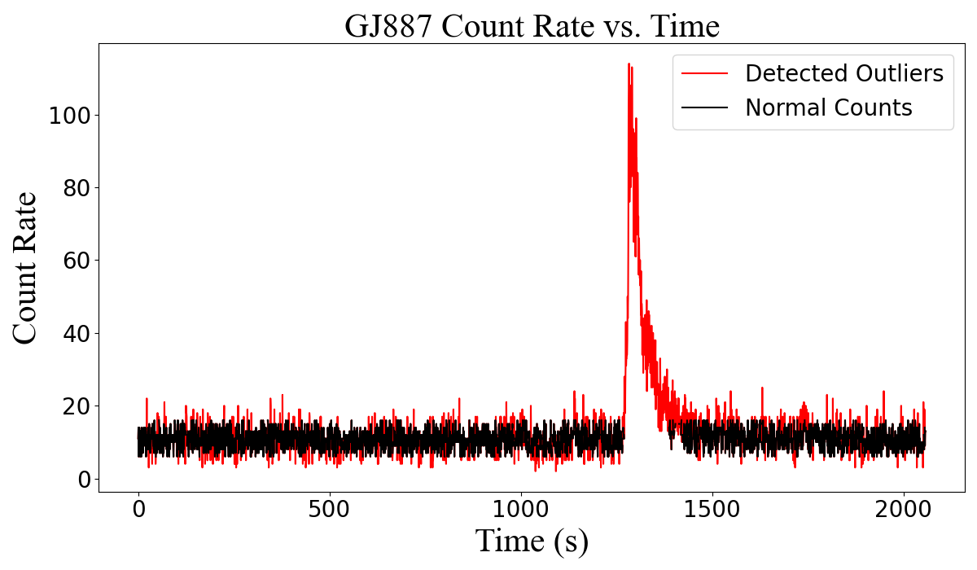
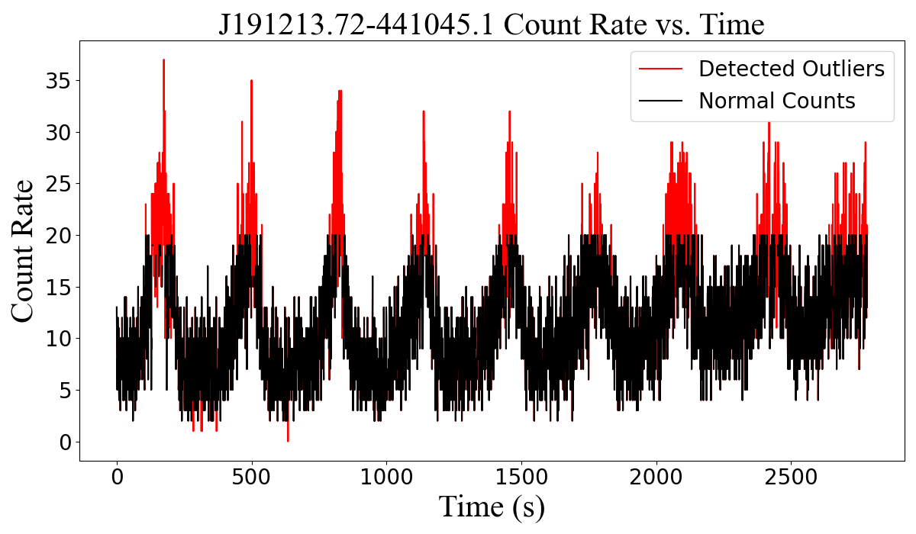
More Intrinsically Variable Objects
Notes:
Top left: white dwarf binary
Top right: Black hole binary
Bottom Left: Red dwarf
Bottom Right: white dwarf and m-dwarf binary

Slide 25
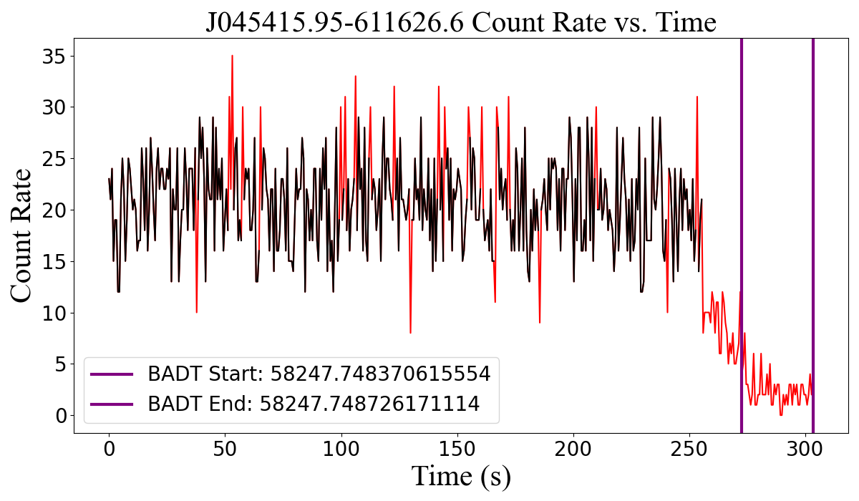
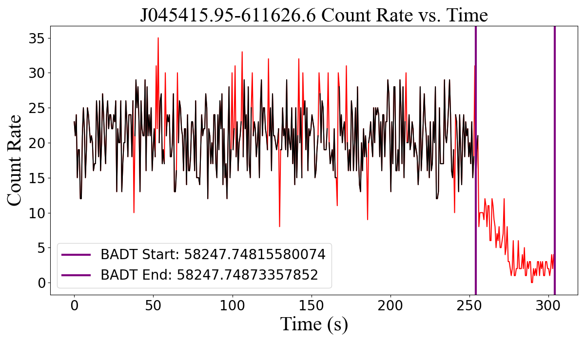
Automated Bad Time Selection (Where Max Seg Fails)

